Slide 1
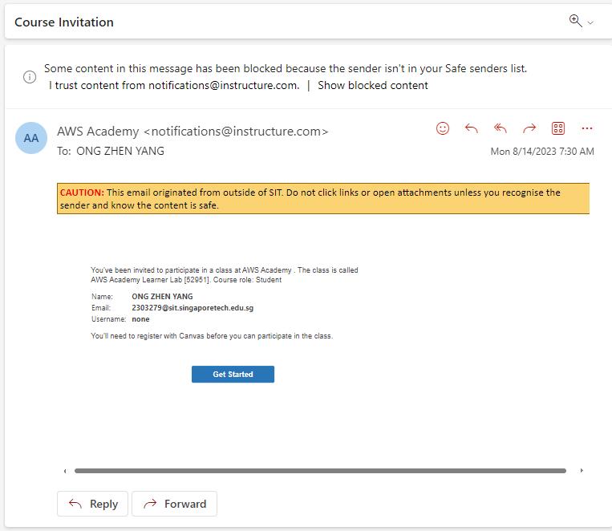
You should have received an email like this

Slide 2
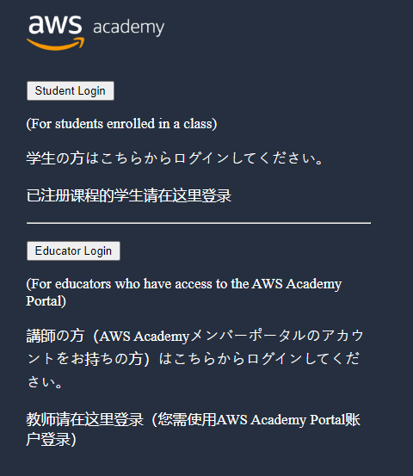
Or just use this link
https://www.awsacademy.com/vforcesite/LMS_Login

Slide 3
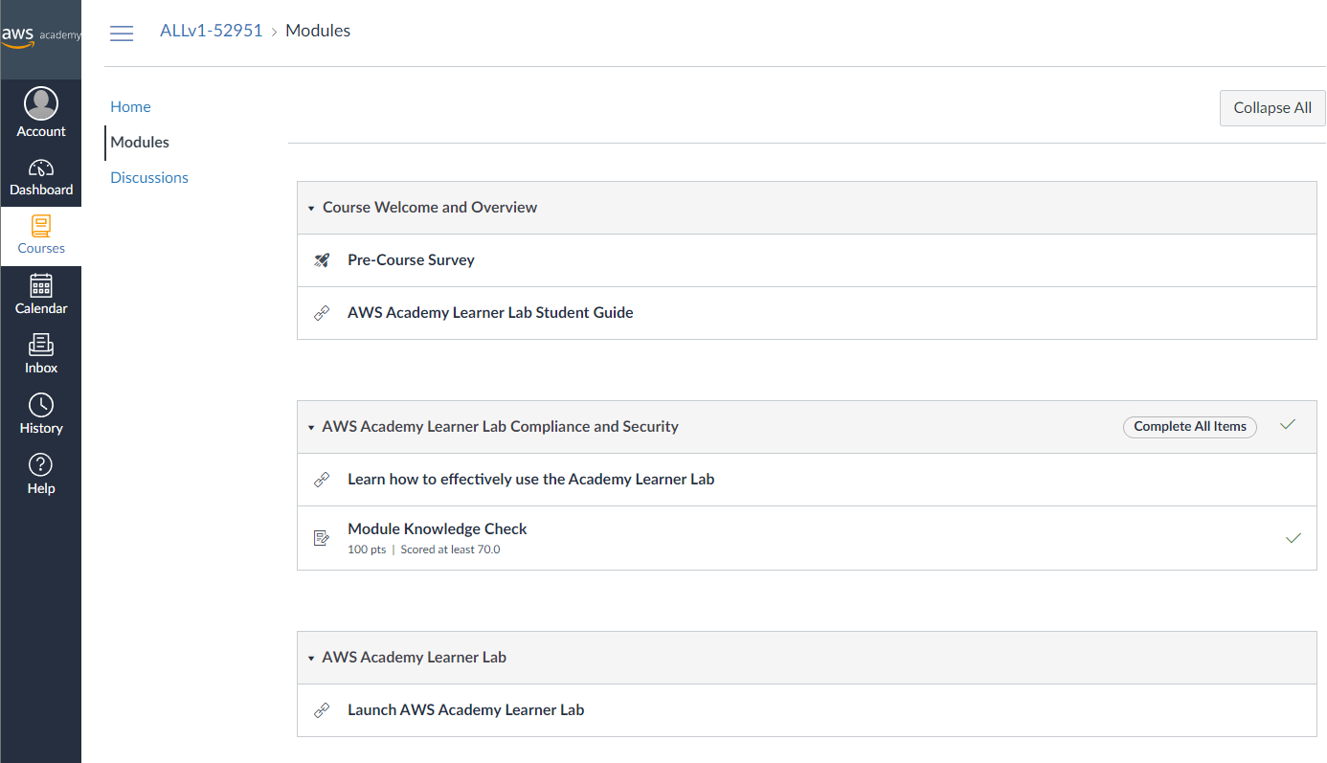
After You log in, Go to AWS learner Lab

Slide 4
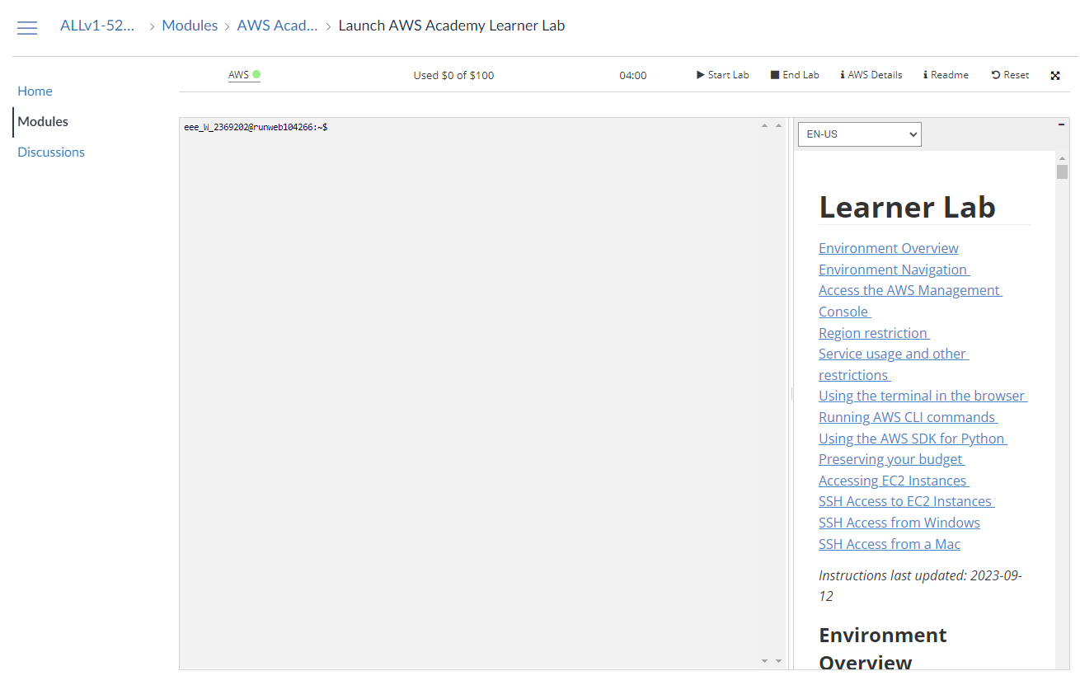
Press “START LAB” and Wait a While

Slide 5
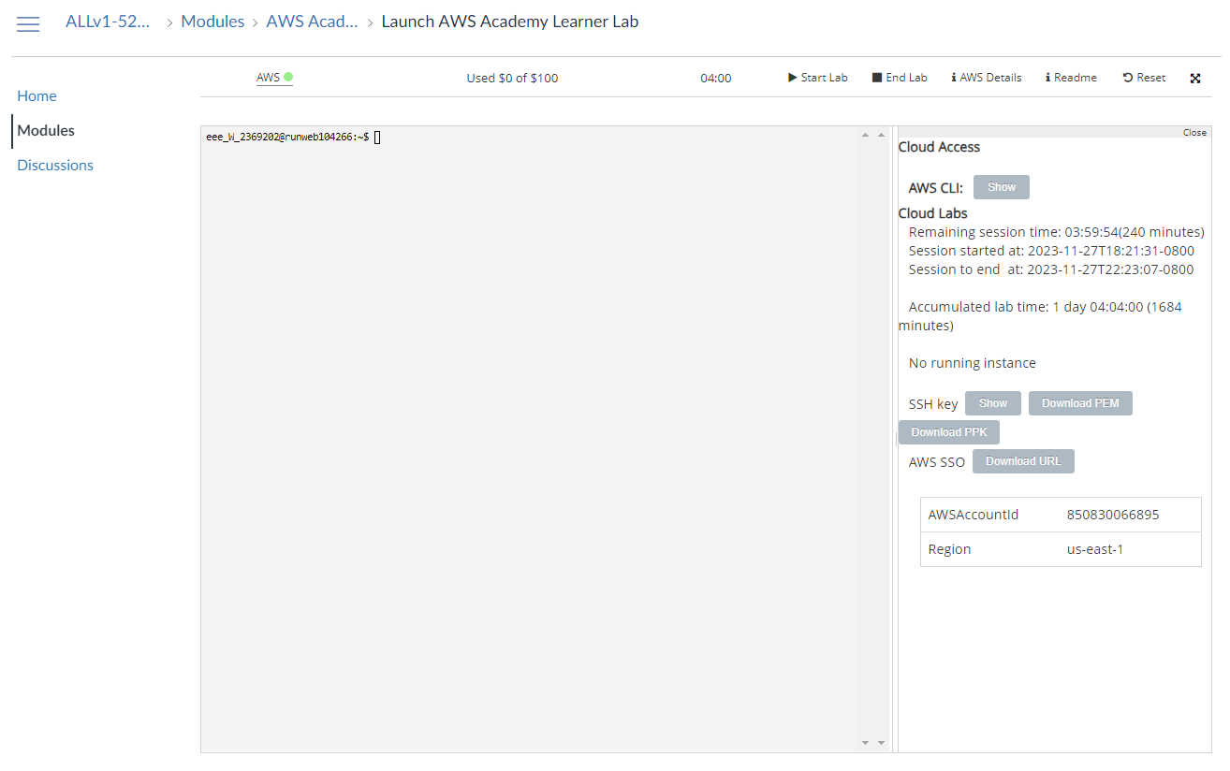
Press “AWS DETAILS” and DOWNLOAD URL

Slide 6
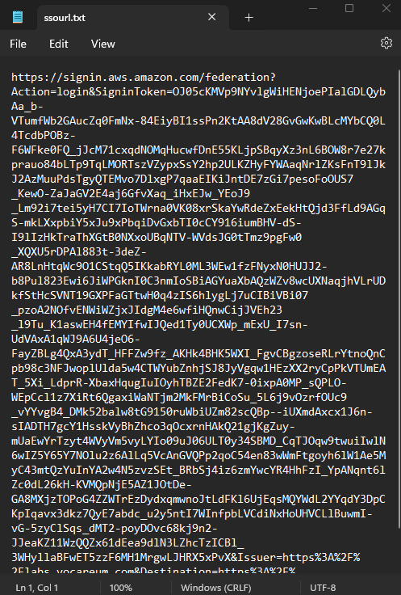
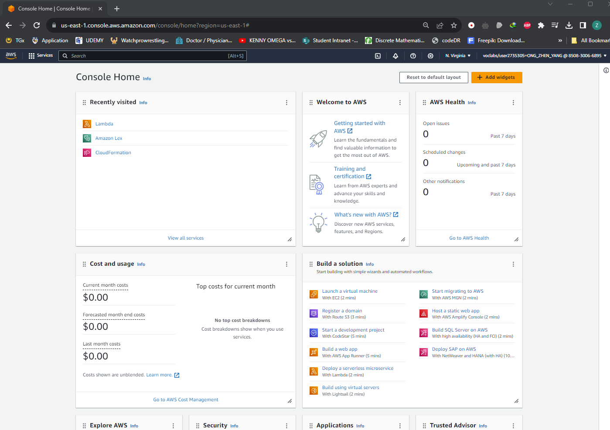
OPEN THE ssourl.tx DOWNLOADED AND PASTE THE LINK INTO A NEW TAB

